Slide 1
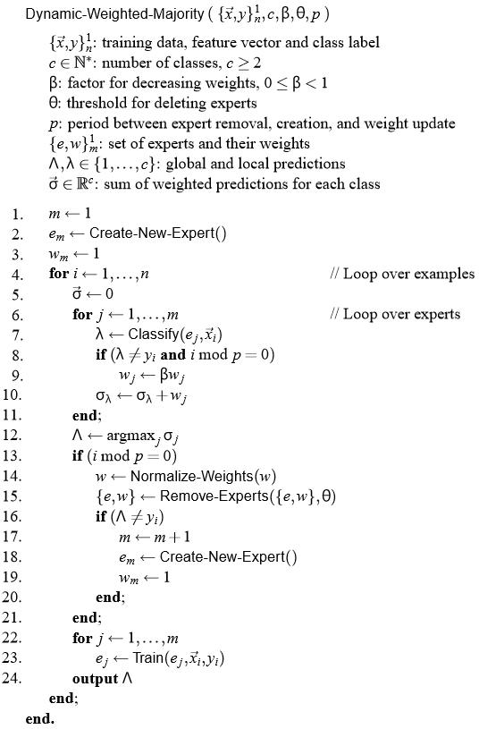
Assignment III
Dynamic Weighted Majority
José Manuel Pérez Ricote

Slide 2

Goal: Implement DWM in Stagger and SEA datasets.

Slide 3
The algorithm: DWM
Ensemble method for concept drift that dynamically creates and removes weighted experts in response to changes in performance.
The method uses four mechanisms to cope with concept drift:
It trains online learners of the ensemble.
It weights those learners based on their performance.
It removes them, also based on their performance
It adds new experts based on the global performance.

Slide 4
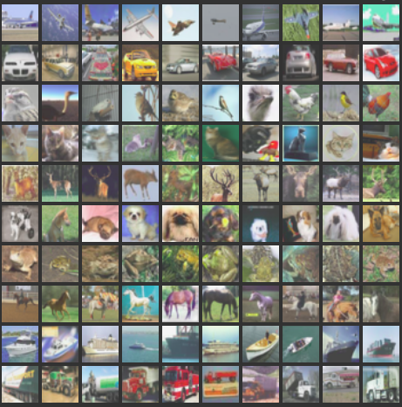

The datasets
The algorithm has been implemented in two datasets:
Stagger concept
SEA dataset

Slide 5
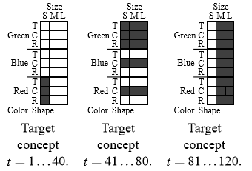
Stagger concept: Basic explanation
Three features: size, shape and color.
Two output labels: yes and no (1/0).
One-hot encode features and labels.
Two concept drifts in 120 time steps:
At t = 40
At t = 80

Slide 6
Stagger concept: Parameter tuning
Threshold for expert removal: θ = 0.01
Factor for weights adjustment: β = 0.5
Period between expert removal or creation, and weight update: p = 1
Maximum number of learners: Not defined yet

Slide 7
SEA dataset: Basic explanation
Three features: x1, x2 and x3, with continuous values between 0 and 10.
Feature x3 is irrelevant for the purpose of the implementation.
Two output classes: 0 and 1. It is 1 when x1 + x2 > b, with values b = [7, 8, 9, 9.5]
Three concept drifts in 5000 time steps (every range with a different b value):
At t = 1250
At t = 2500
At t = 3750

Slide 8
SEA dataset: Parameter tuning
Threshold for expert removal: θ = 0.001
Factor for weights adjustment: β = 0.5
Period between expert removal or creation, and weight update: p = 5
Maximum number of learners: m = 5 or m = 10
Number of test samples per time step: n = 2500

Slide 9

The results
The evaluation has been performed using different sets of parameters.

Slide 10
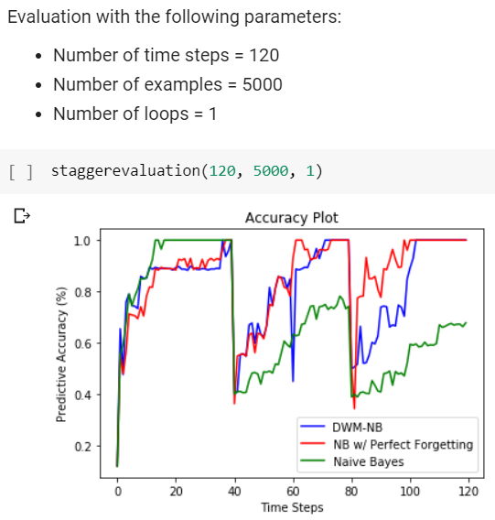
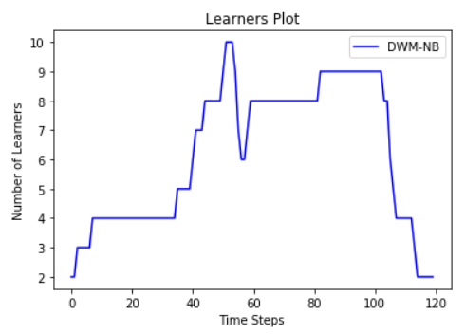
Stagger evaluation #1

Slide 11
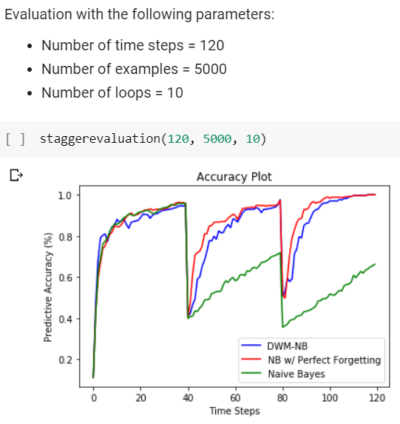
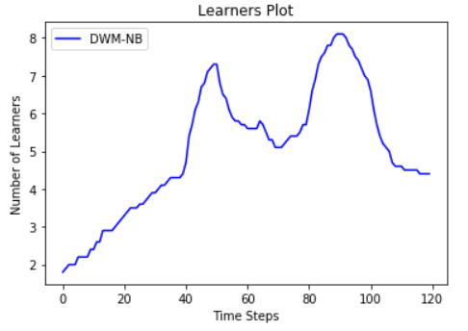
Stagger evaluation #2

Slide 12
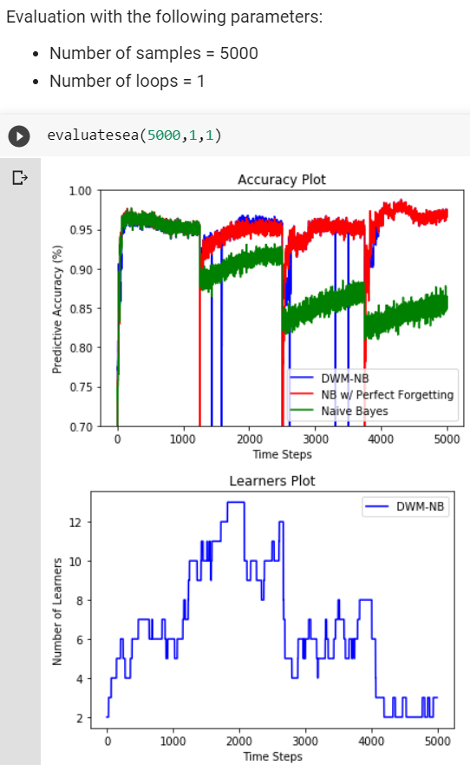
SEA evaluation #1

Slide 13
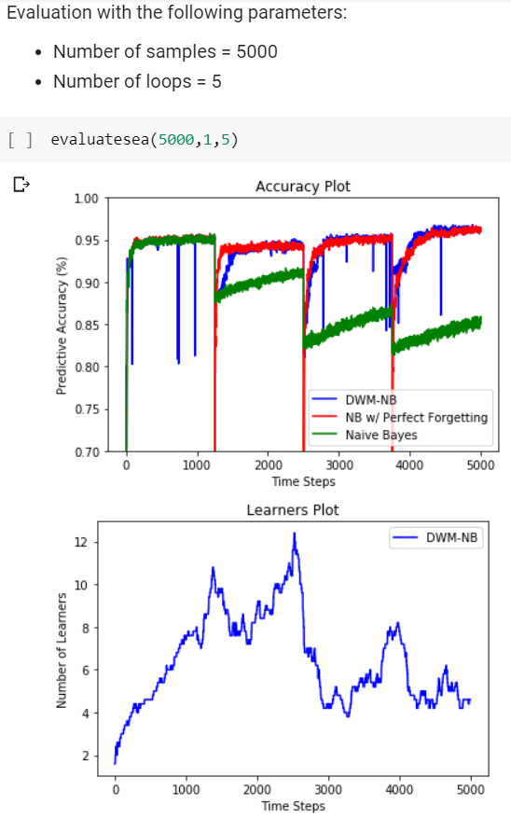
SEA evaluation #2

Slide 14
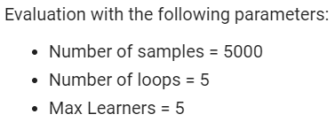
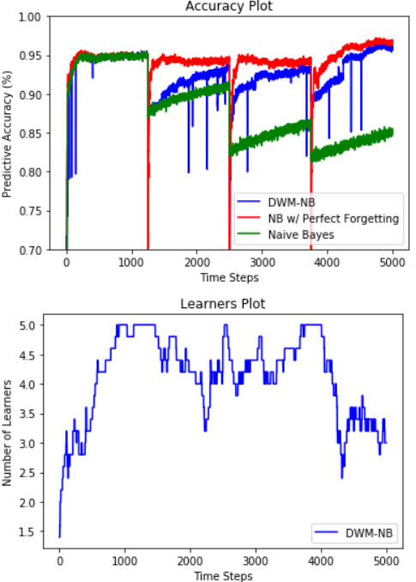
SEA evaluation #3

Slide 15
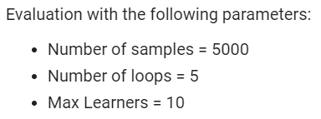
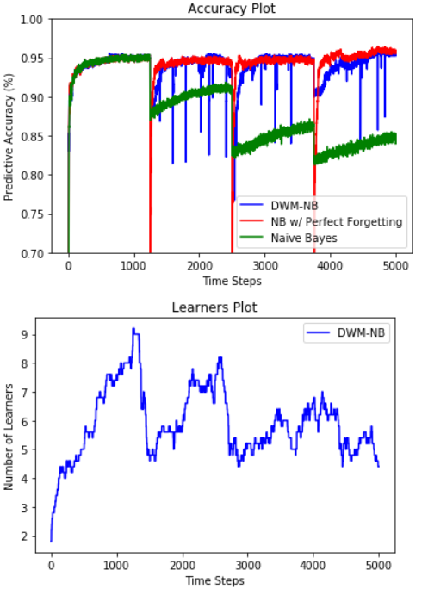
SEA evaluation #4

Slide 16
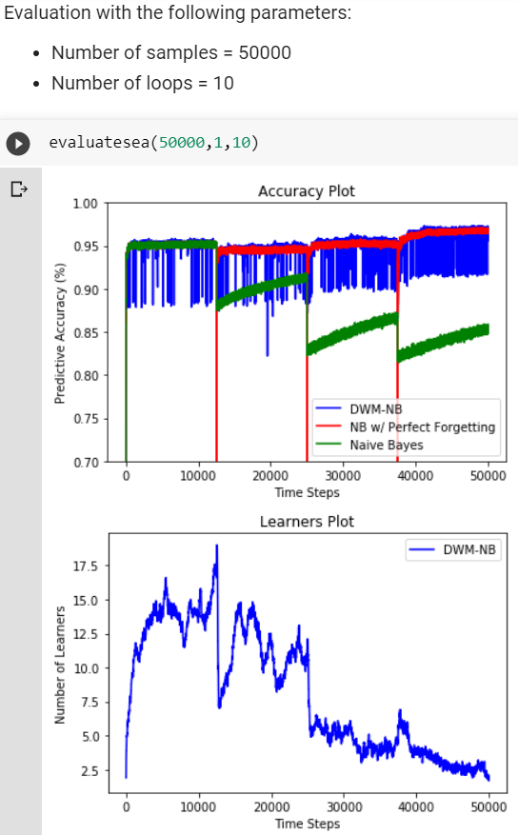
SEA evaluation #5

Slide 17


THANK YOU!
Questions & Answers

